Slide 1

Foundations of Artificial Intelligence: From Theory to Implementation
A Presentation by [Your Name]
Instructor: Rajoshri Prozzowal Talukdar

Slide 2
Chapter 1: Defining Artificial Intelligence
Artificial Intelligence is the study of agents that receive percepts from the environment and perform actions.
1
2
Acting Humanly
Thinking Humanly
The Turing Test approach. Machines that can exhibit intelligent behavior equivalent to, or indistinguishable from, that of a human.
The cognitive modeling approach. Building systems that think like humans, often using introspection and psychological experiments.
3
4
Thinking Rationally
Acting Rationally
The "laws of thought" approach. Using formal logic and rigorous reasoning to solve problems.
The rational agent approach. Designing systems that act to achieve the best expected outcome.
The central concept across these categories is the Agent.

Slide 3


Intelligent Agents: Interacting with the Environment
The Core Loop
Rational Action
An agent perceives its environment through sensors and acts upon that environment through effectors.
A rational agent acts in a way that is expected to maximize its performance measure, given the percept sequence and its prior knowledge.
Sensors
Receive percepts from environment
Agent
Effectors
Perceives then acts to achieve goals
Perform actions on environment
Percepts
Information received by sensors
AI goals range from creating systems that merely perform a task to creating full learning agents that adapt and improve over time.

Slide 4



Chapter 2: Problem Solving with Uninformed Search
State Space Search
Uninformed Strategies
Problems are modeled as a search through a defined state space, moving from an initial state to a goal state.
These algorithms have no information about the closeness of a goal state, relying only on the structure of the search tree.
Key Uninformed Algorithms
Breadth-First Search (BFS)
Applications: These techniques are foundational and used in problems like the 8-Puzzle and the N-Queen problem.
Depth-First Search (DFS)
Iterative Deepening Search (IDS)
Bidirectional Search

Slide 5
Informed Search: Harnessing Heuristics
Heuristic Functions
A* Search Algorithm
AO* Algorithm
Functions that estimate the cost from the current state to the goal state. They guide search toward promising paths.
Optimal and complete search using the cost function f(n) = g(n) + h(n). Requires an admissible heuristic.
An extension of A* for searching AND/OR graphs, used in decomposition-based problem solving.
For the 8-Puzzle, common heuristics include Manhattan distance and the number of misplaced tiles. Admissibility ensures that the heuristic never overestimates the true cost to reach the goal.

Slide 6


Optimization & Local Search Techniques
Hill Climbing
Strengths and Limitations
A simple local search algorithm that continuously moves in the direction of increasing value.
Strength: Requires very little memory, only tracking the current state.
The state space landscape is treated like a geographical terrain to be climbed.
Limitation: Prone to getting stuck in local maxima or plateaus, unable to find the global optimal solution.
Useful for finding a "good enough" solution quickly, rather than the absolute best.
The Beam Search algorithm extends local search by keeping track of a limited number (k) of best states in the current layer, preventing being trapped by single poor decisions.

Slide 7

Chapter 3: Adversarial Search and Game Playing
Min-Max for Zero-Sum Games
Tree Generation
The Min-Max Principle
The game is represented as a tree, exploring possible moves up to a certain depth (the search horizon).
A recursive algorithm that assumes optimal play from the opponent. MAX seeks to maximize its score, MIN seeks to minimize MAX's score.
Alpha-Beta Pruning
Evaluation Function
A crucial optimization technique that eliminates branches of the search tree that do not affect the final result, dramatically improving performance.
Used to assign a value to non-terminal states at the search horizon.
This methodology is the core of classic game AI, from Tic-Tac-Toe to Chess programs.

Slide 8



Constraint Satisfaction Problems (CSPs)
Domains (D)
The possible values each variable can take.
Variables (X)
The set of decision variables in the problem.
Constraints (C)
A set of rules that restrict which values can be assigned simultaneously.
Backtracking Algorithm
Bound Propagation
The standard approach for CSPs. It assigns values to one variable at a time, checking constraints, and backtracking when a constraint is violated.
Techniques like Arc Consistency (AC-3) that proactively reduce the domains of unassigned variables to prune the search space before constraint violations occur.

Slide 9
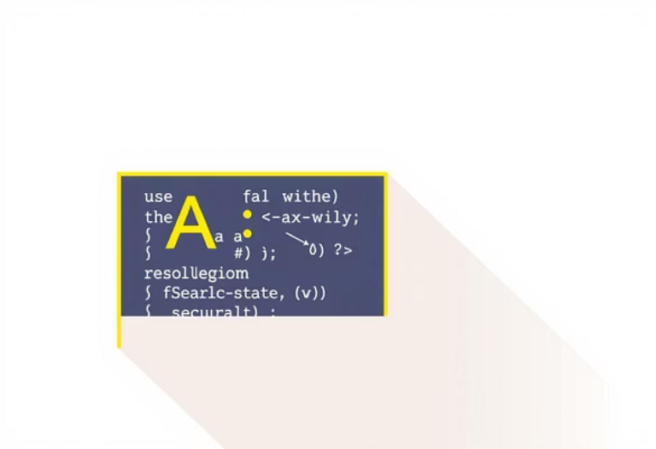

Lab Implementation: Essential AI Algorithms
Translating theoretical algorithms into functional code requires careful consideration of data structures and complexity.
A* Implementation
1
Utilizing a priority queue to efficiently manage the frontier and ensure optimality.
2
N-Queen Solver
Applying backtracking with forward checking for efficient constraint satisfaction.
Hill Climbing
3
Practical use in finding optimal configurations (e.g., shortest path approximations).
A detailed complexity analysis confirms the theoretical efficiency of informed search over uninformed methods.

Slide 10

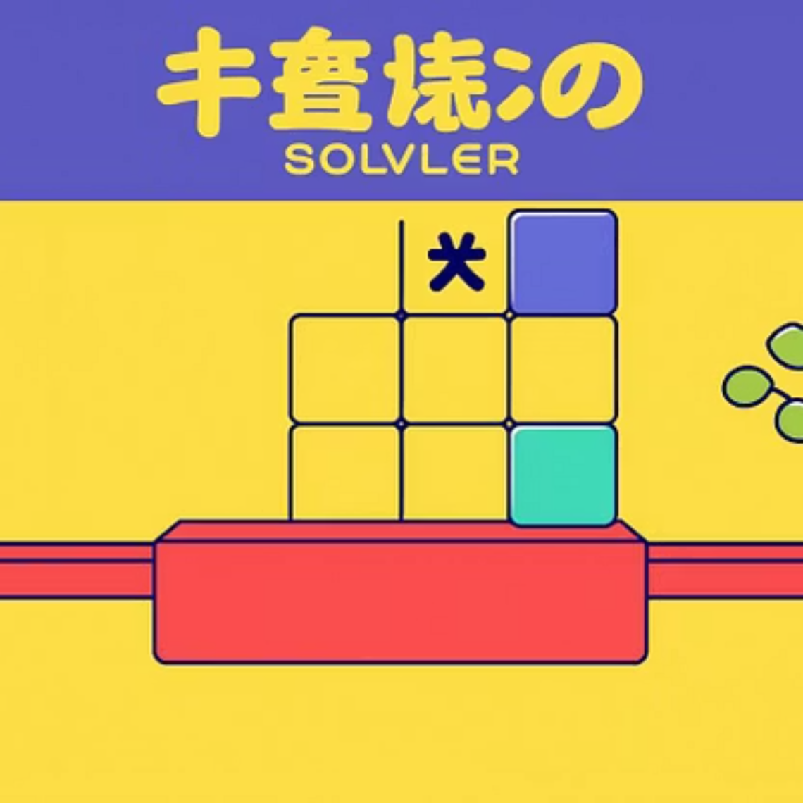

Lab Implementation: Building AI Games
Game development provides a tangible and exciting environment for applying adversarial search concepts.
Tic-Tac-Toe with Min-Max
Puzzle Solvers
Practical Application
A perfect demonstration of optimal game play derived from exhaustive tree search.
Using A* search to find the shortest sequence of moves to solve classic puzzles, showcasing heuristic power.
These foundational game AIs scale up to more complex challenges with deeper search limits and more sophisticated evaluation functions.

